Slide 1
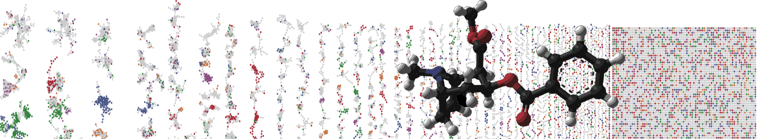


GNPS – LCMS Dashboard
HANDS ON
ENTER AUTHORS HERE
University of California - San Diego

Slide 2
Objectives and Data
https://gnps-lcms.ucsd.edu/
Visualize/Explore LCMS Files in the Browser
Explore different ways to reach interface

Slide 3
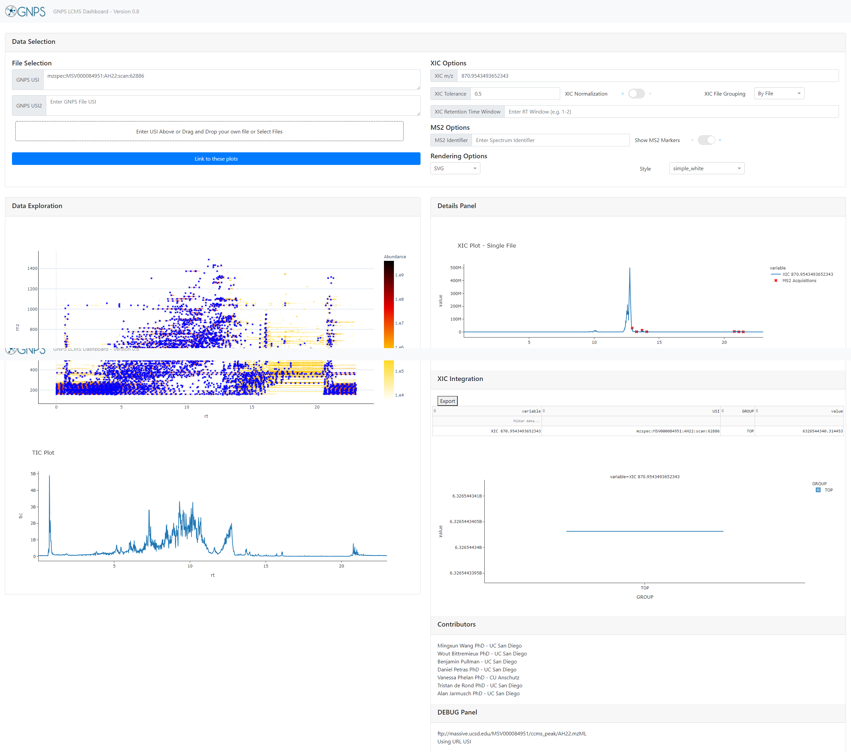

Interactively Exploring LCMS Data
Full LC/MS Mass Spec File
Visualize

Slide 4

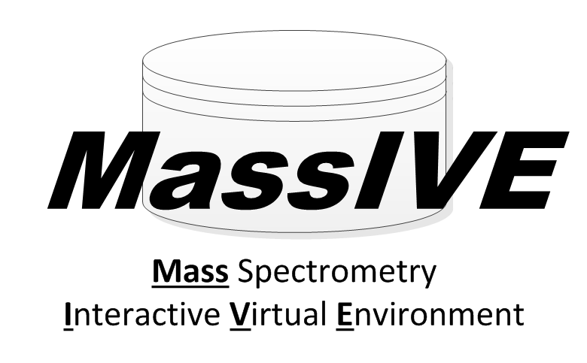

Interactively Exploring LCMS Data
Visualize
Your Data in GNPS Jobs
Your Data to Upload
Public Metabolomics Data

Slide 5
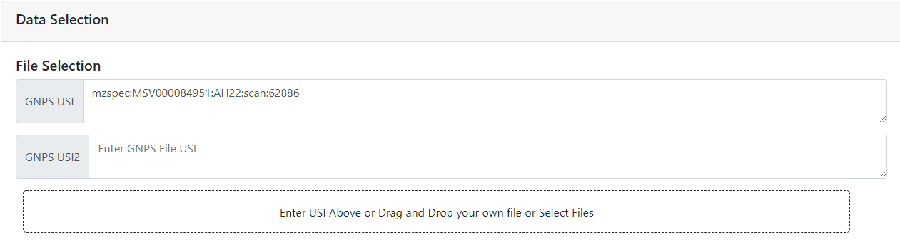
Selecting Data
Enter Universal
Spectrum Identifier
Identifiers Source
Your Data in GNPS Jobs
Public Metabolomics Data

Slide 6
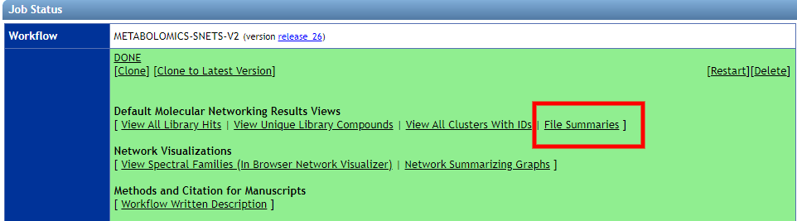
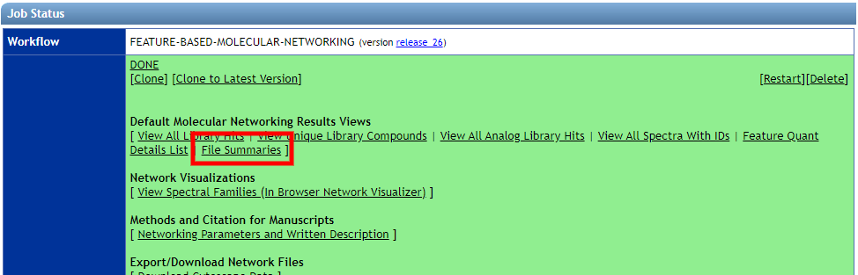
Selecting Data from GNPS Jobs
Classical Molecular Networking
Example Link
FBMN
Example Link

Slide 7
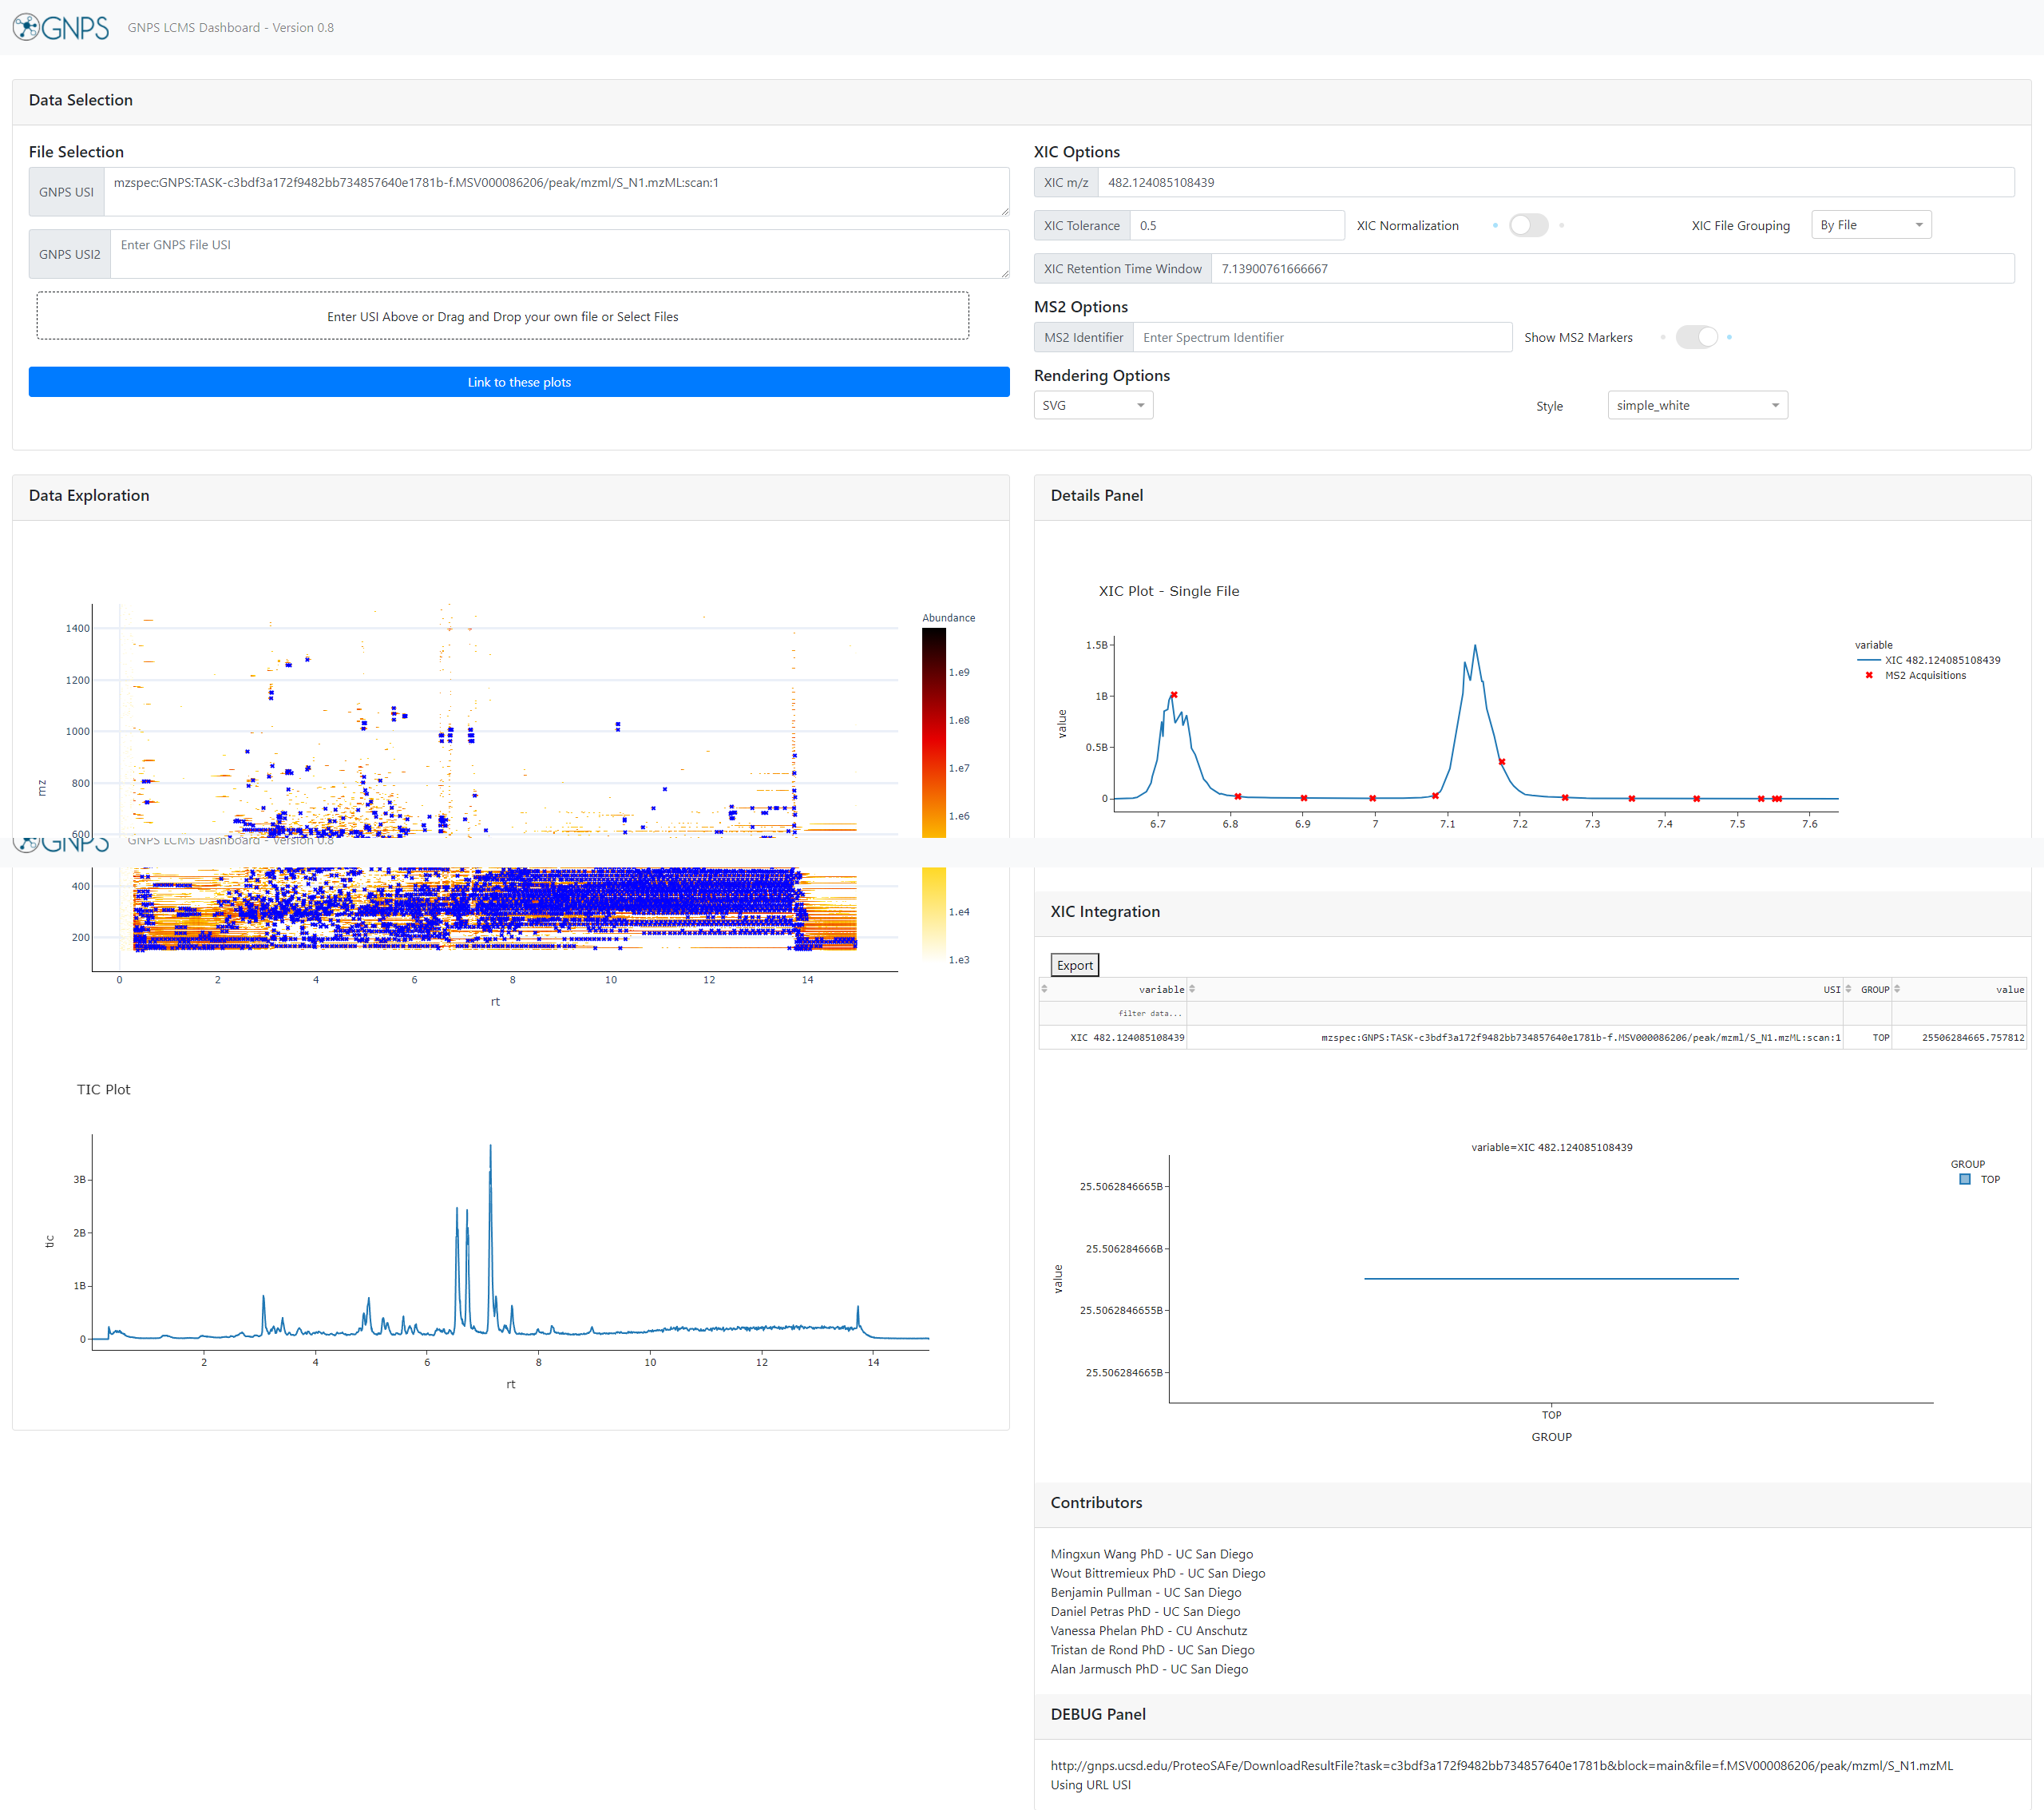
Visualizing in Interface
1.
2.
Data Selection
XIC Plotting Options
2D LCMS Heat Map
TIC Plot
XIC Plots/MS2 Plots
XIC Integration Results/Boxes
3.
5.
6.
4.
Example Link

Slide 8
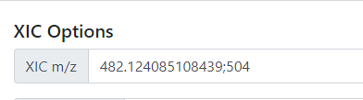
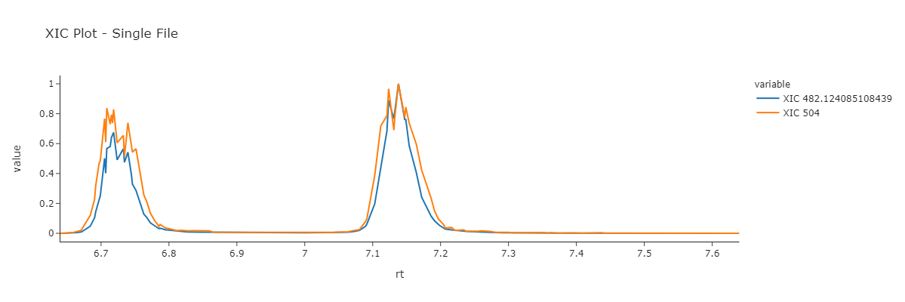
XIC on Multiple m/z
Example Link

Slide 9
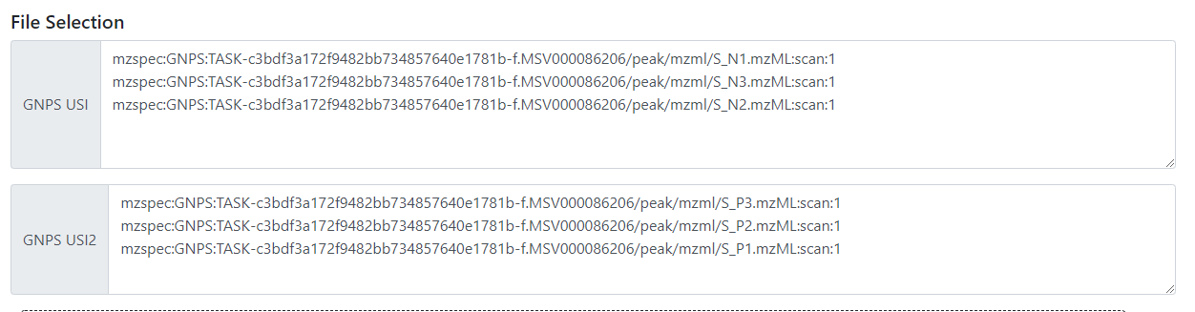
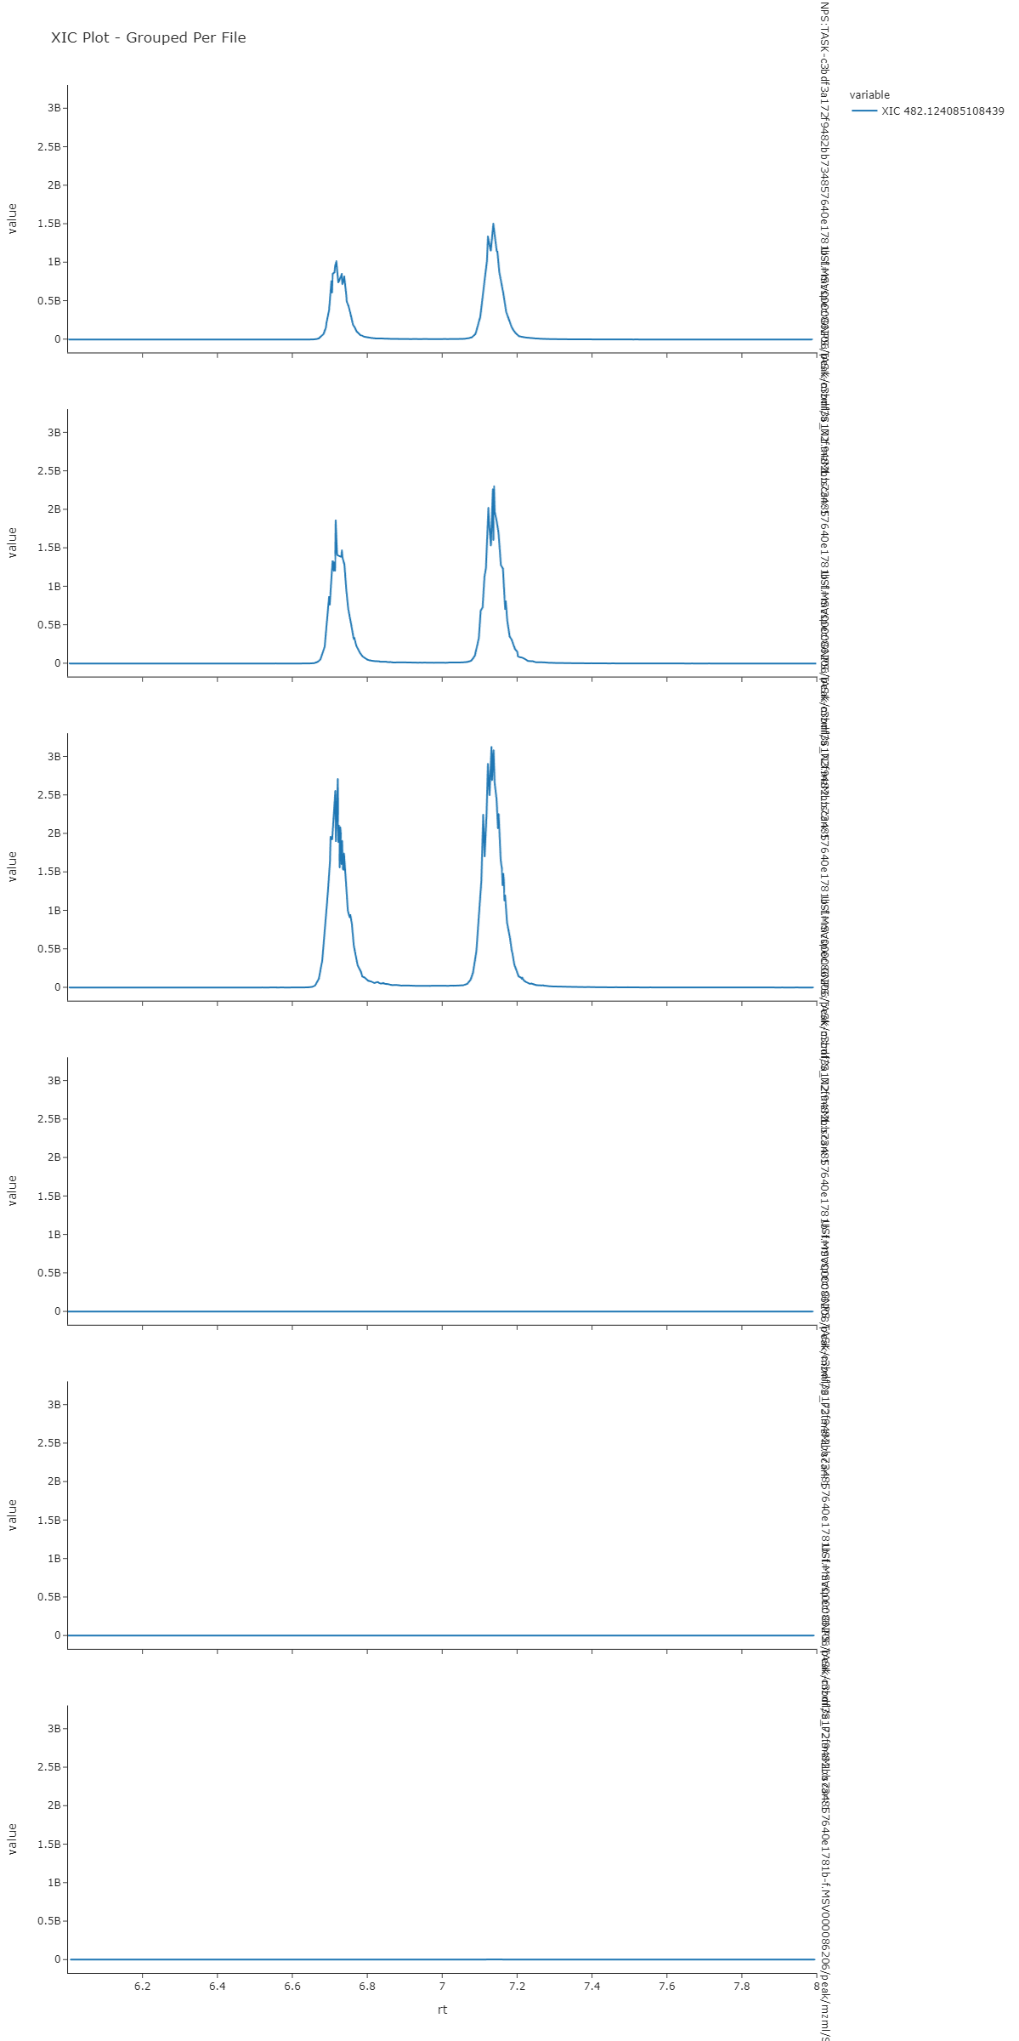
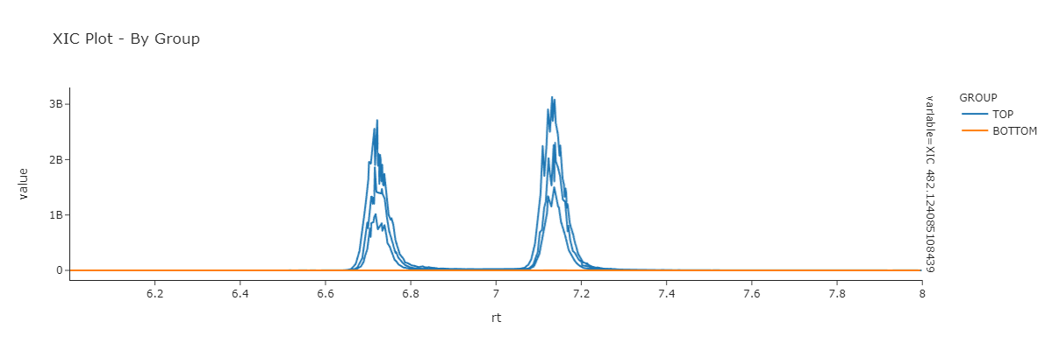
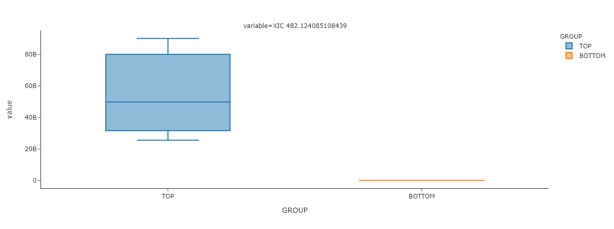
XIC Comparison on Multiple Files
Example Link

Slide 10
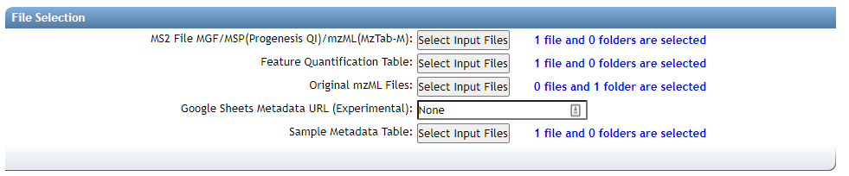
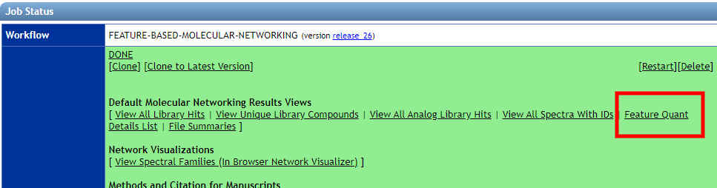
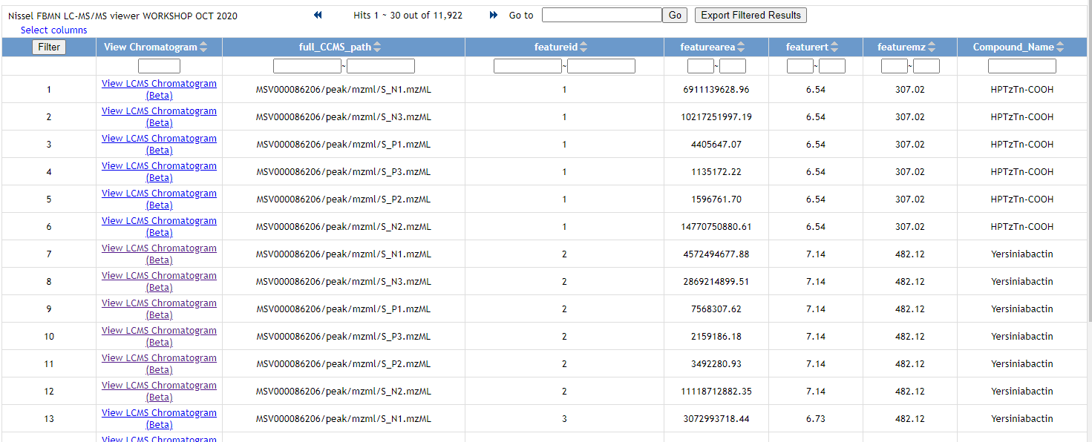
Inspecting Feature Finding Results from FBMN
Select All Original mzML Files
View Feature Quant Details List
Listing All Features across all files
Example Link

Slide 11
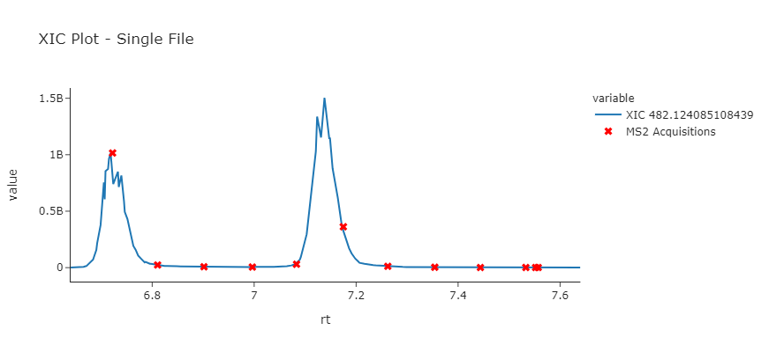
Inspecting Feature Finding Results from FBMN
Listing All Features across all files
Easily View Each Feature
Example Link

Slide 12
Questions, Problems or Bugs?
Documentation: https://ccms-ucsd.github.io/GNPSDocumentation/
Forum: https://groups.google.com/forum/#!forum/molecular_networking_bug_reports
PRESENTER NAMES AND EMAILS HERE

